Slide 1
ManPy Experiments
Erik Hass

Slide 2
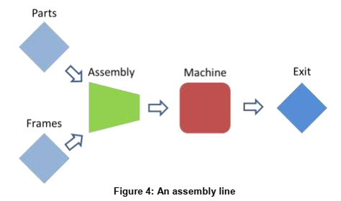
Basic ManPy
Get statistics like:
Produced Parts
Blockage Time
Working Time
Setup Time
Completed Jobs
etc.

Slide 3
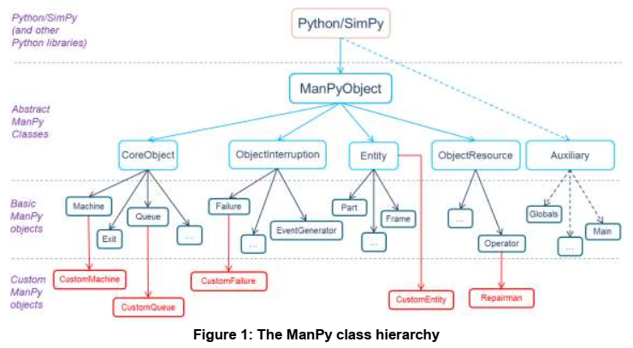
Object Property
Feature:
Simulate Features on Entities when they exit a machine
TimeSeries:
Simulate multiple Datapoints based on a function

Slide 4
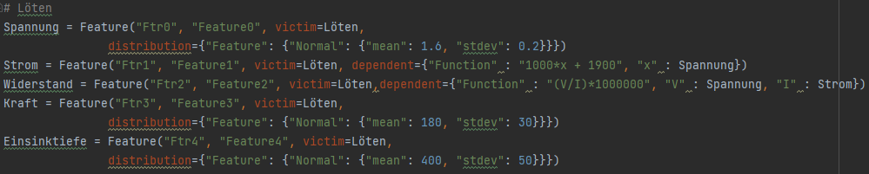
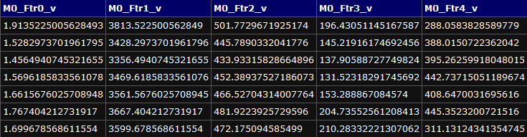
Feature Example

Slide 5
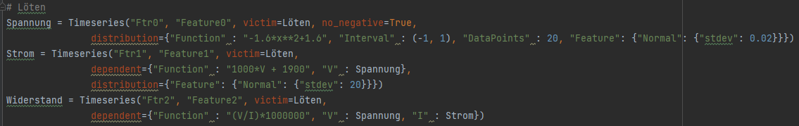
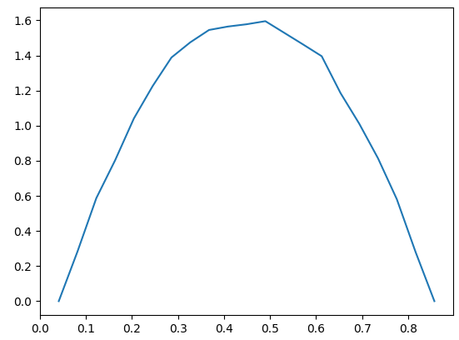
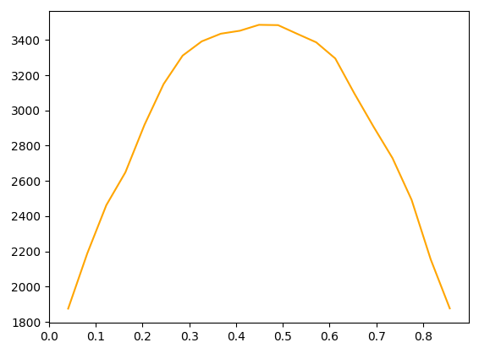
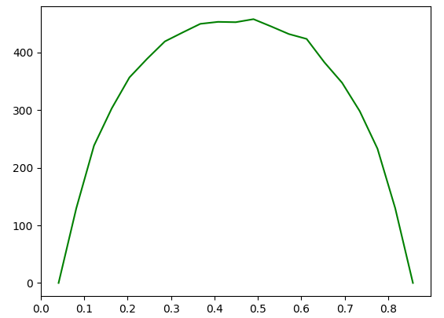
Time-Series Example

Slide 6
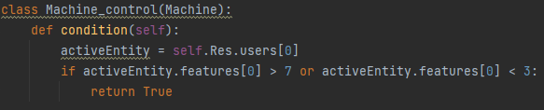
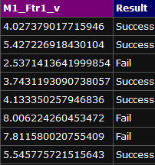
Quality Control

Slide 7
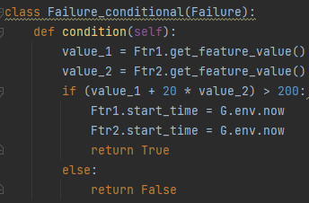
Failure Conditional

Slide 8
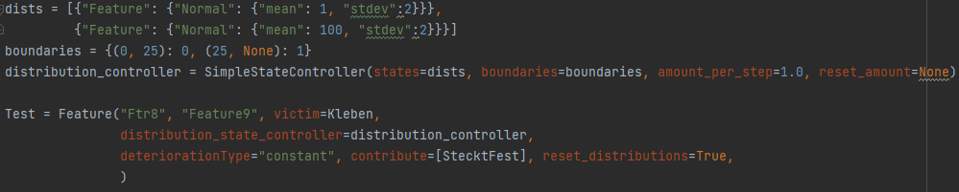
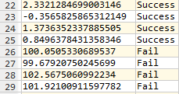
State Controller

Slide 9
Thank you

